Slide 1
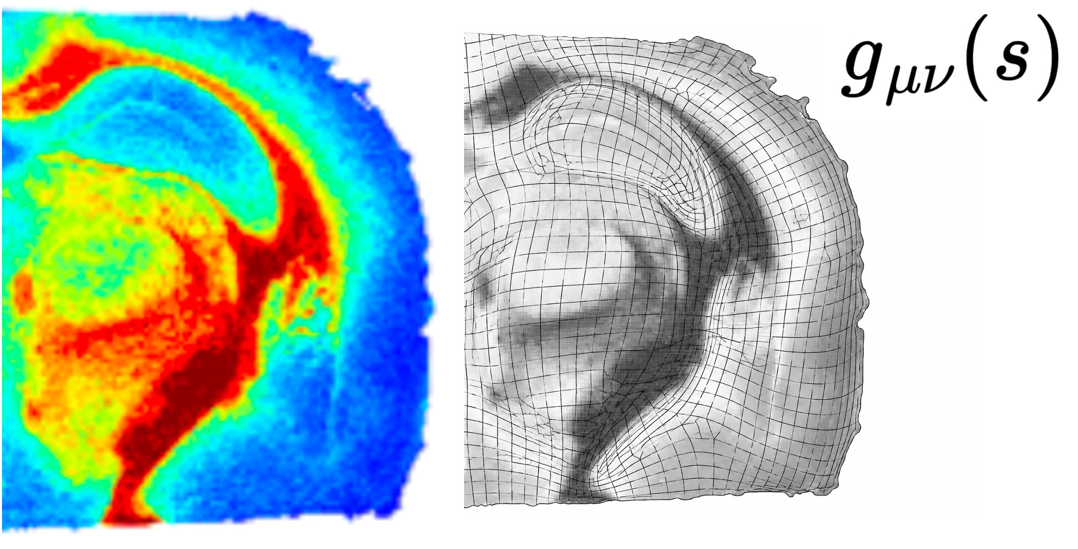
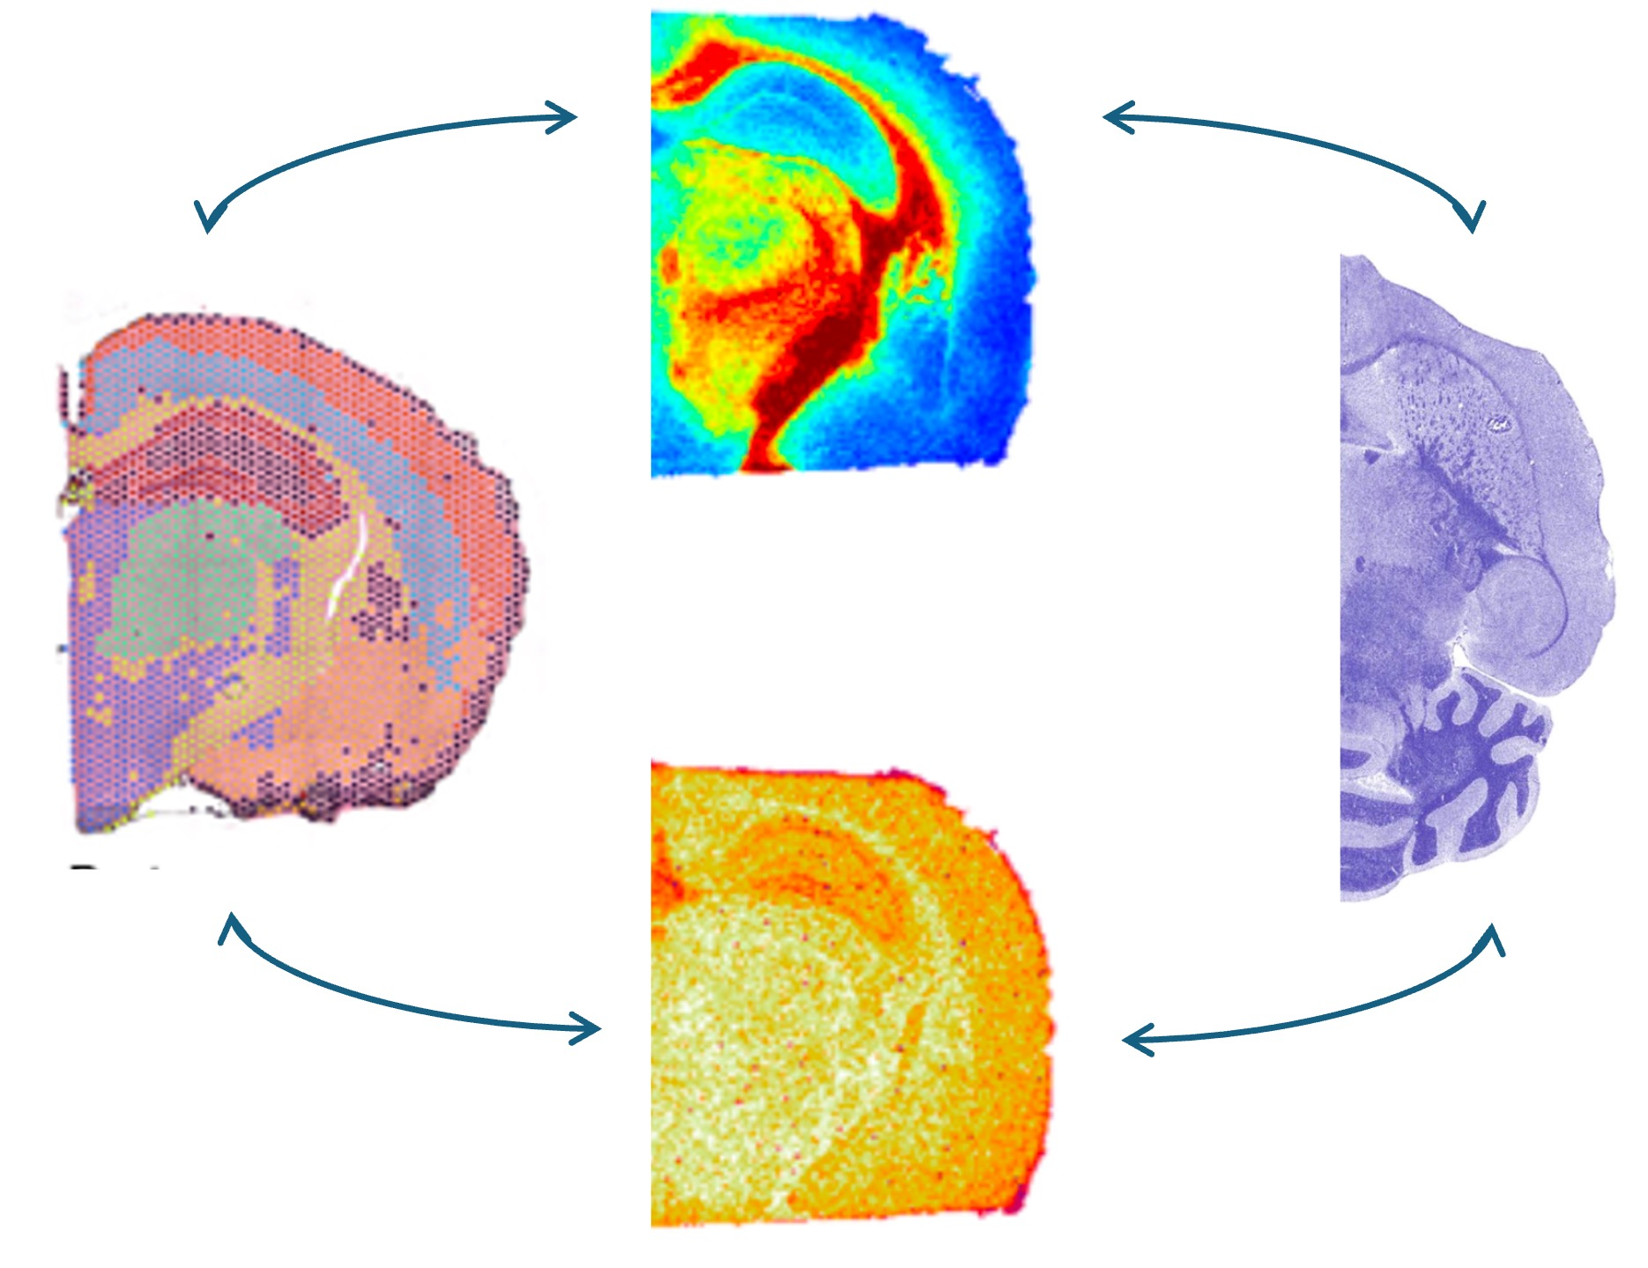




Riemannian Metric Learning for Alignment of Spatial Multiomics
Peter Halmos, Yufan Xia, and Ben Raphael
*Stop by Yufan’s poster at Session D, Poster 188!
Image Source: Xu et al., 2024; Clarke et al., 2025

Slide 2
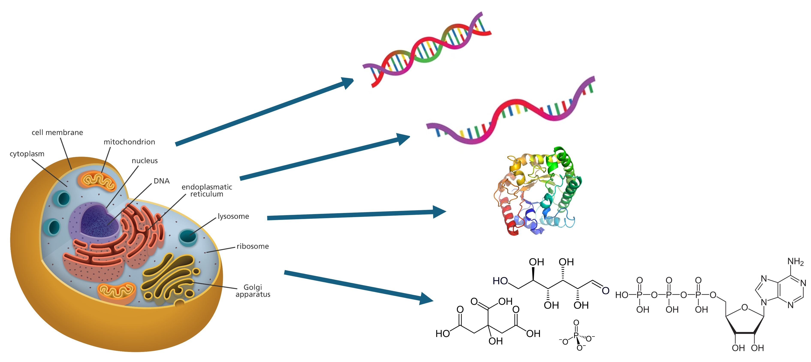
Measurements and sequencing extend to many modality axes!
No cell is just its transcription; cells are inherently multimodal!
Characterizing the mapping between modalities:
Genomics → Epigenomics → Transcriptomics → Proteomics → Metabolomics
is one of the key questions in biology!

Slide 3
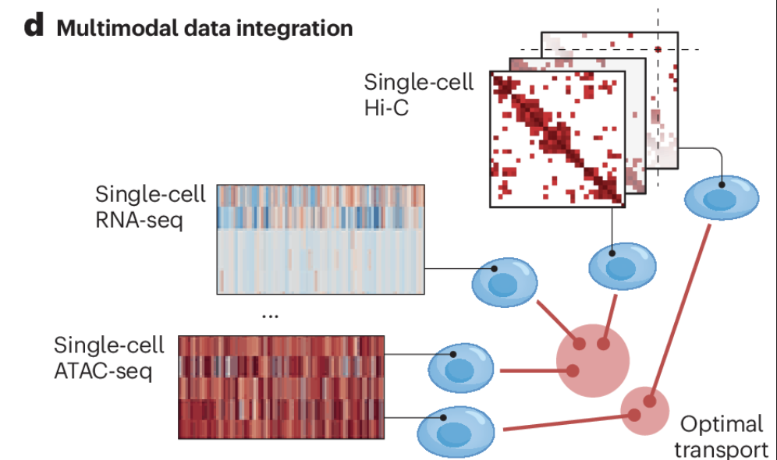
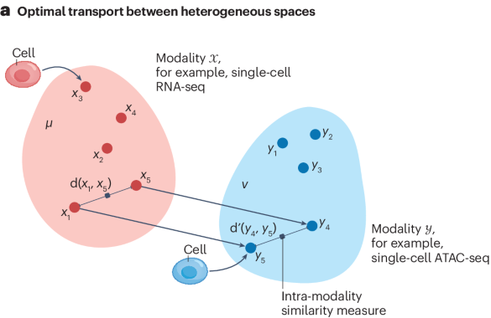
Multimodal Alignment:
Mapping data sequenced across multiple data modality axes
Image Source: Bunne et al., 2024.
To map multi-modal data, many existing methods have emerged to map across single-cell modalities using Gromov-Wasserstein Optimal Transport
SCOT [Demetci, et al. JCB, (Jan. 2022)]
SCOTv2 [Demetci, et al. JCB, (Nov. 2022)]
moscot Translation [Klein, et al. Nat. Met., (2025)]

Slide 4
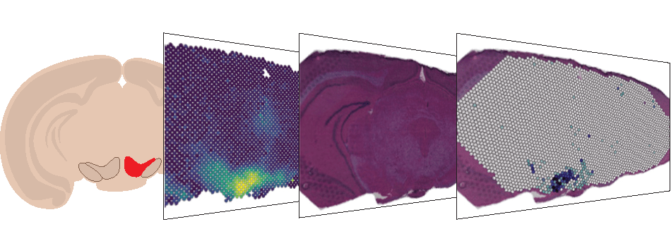
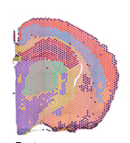
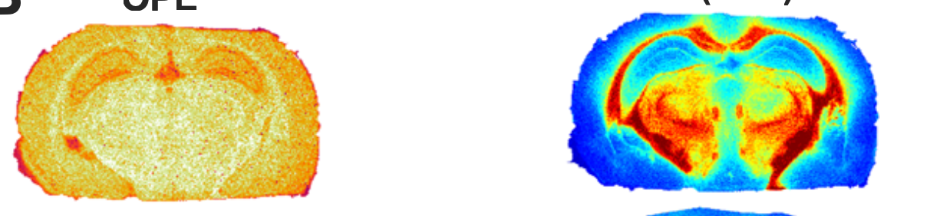
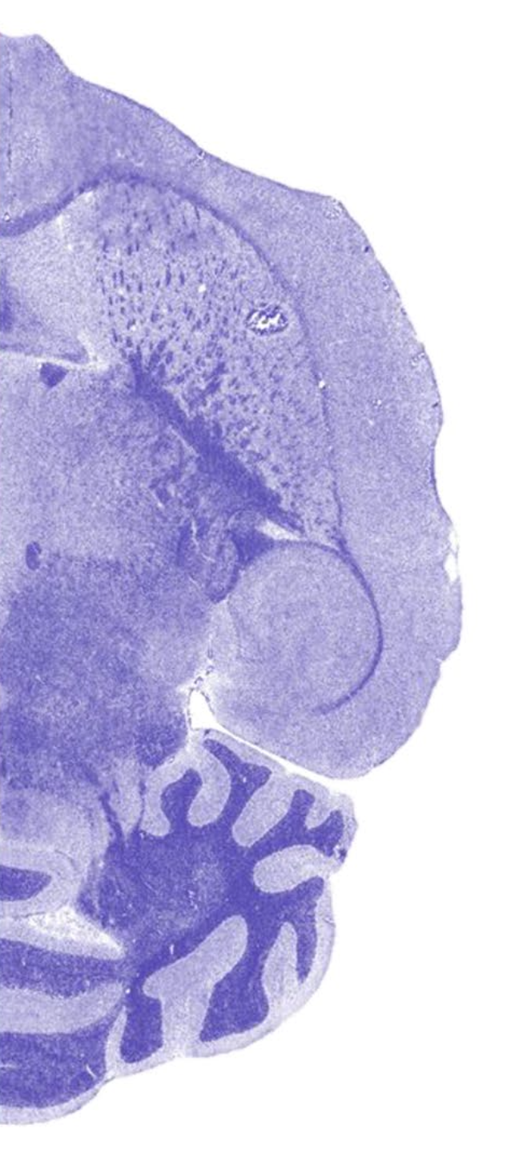
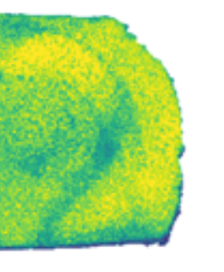
Spatial Multiomics:
Biology is fundamentally spatial !
Key technologies have emerged to measure distinct modalities across space:
  Spatial Transcriptomics [Ståhl et al.,2016; Rao et al., 2021; Moses et al., 2022]
  Metabolomics [Caprioli et al., 1997; co-assay with histology, Vicari et al., 2023]
  Chromatin and Spatial ATAC [Deng et al. 2022, co-assay with RNA, Zhang et al. 2023]
  Also - Proteomics, Lipidomics, H&E, glycomics, and many, many more…
Etc., etc., and etc.!
Transcriptome
Lipidome
Metabolome
Proteome
Glycome
Image Source: Xu et al., 2024; Clarke et al., 2025

Slide 5
Spatial Multiomics Alignment: Fundamental Difficulties
Cross-modal measurements are in fundamentally different spaces
  No common notion of scale
  Differing dimensionality
  Differing morphologies
  Differing readouts
    mRNA molecule counts (transcriptomics)
    Antibody signal intensity (proteomics)
    Metabolite mass-charge ratio intensity (metabolomics)
    Chromatin Accessibility (ATAC)
    RGB pixel intensities (histology)
“Out-of-box” cost functions insufficient to align across spatial multiomic space! Only comparable through intrinsic geometry.

Slide 6
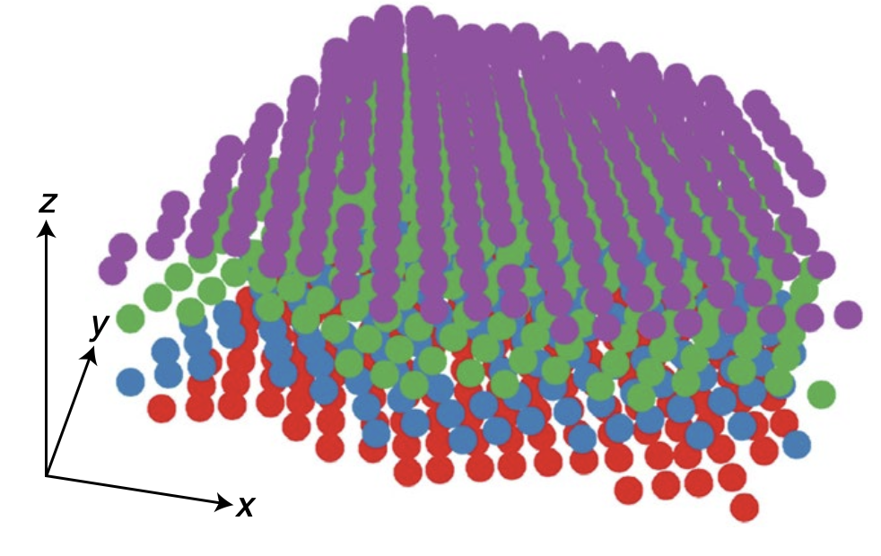
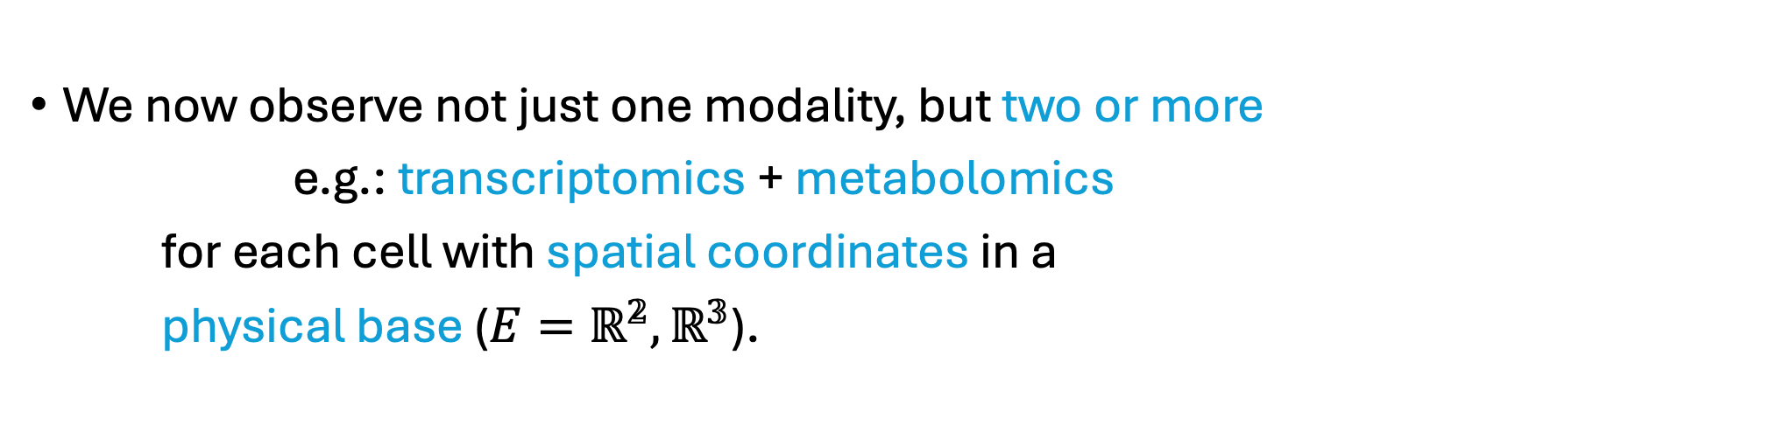
Spatial Multiomics Alignment:
An entirely separate class of methods has been developed for spatial unimodal alignment via Fused Gromov-Wasserstein Optimal Transport:
  PASTE [Zeira, et al. Nat. Met., (2022)]
  PASTE2 [Liu, et al. Gen.Bio., (2023)]
  moscot [Klein, et al. Nat. Met., (2025)]
  DeST-OT [Halmos & Liu et al. Cell Sys. (2025)].
We now observe not just one modality, but two or more
e.g.: transcriptomics + metabolomics
for each cell with spatial coordinates in a
physical base ($E=ℝ^{𝟚},ℝ^{𝟛}$).
Image Source: Xu et al., 2024; Clarke et al., 2025

Slide 7
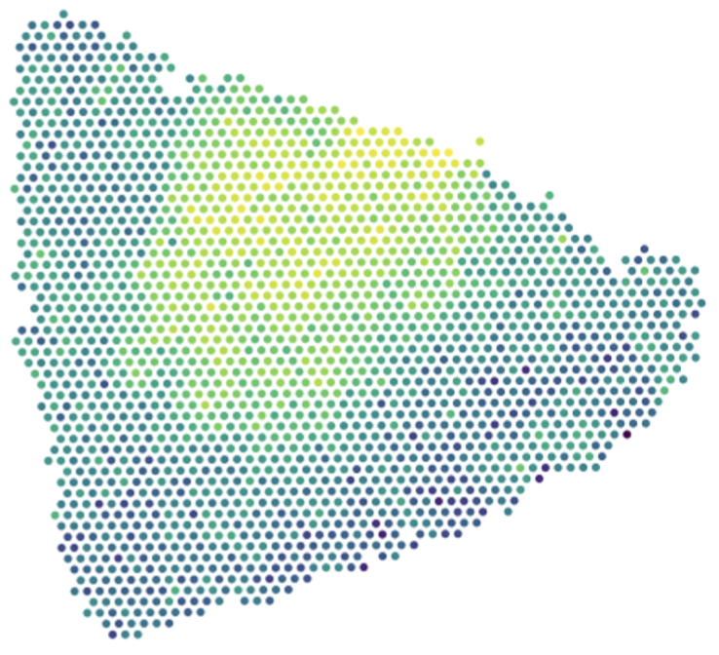
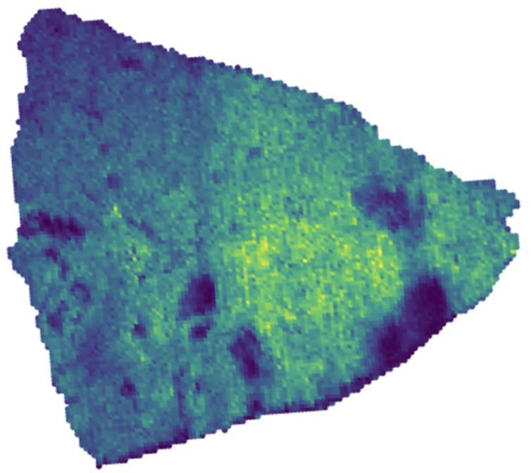
Spatial Multiomics Alignment:
Our central question:
How can we align data across the Spatial Multiome?
Image Source: Xu et al., 2024; Clarke et al., 2025
Data Source: Hu et al., 2024

Slide 8
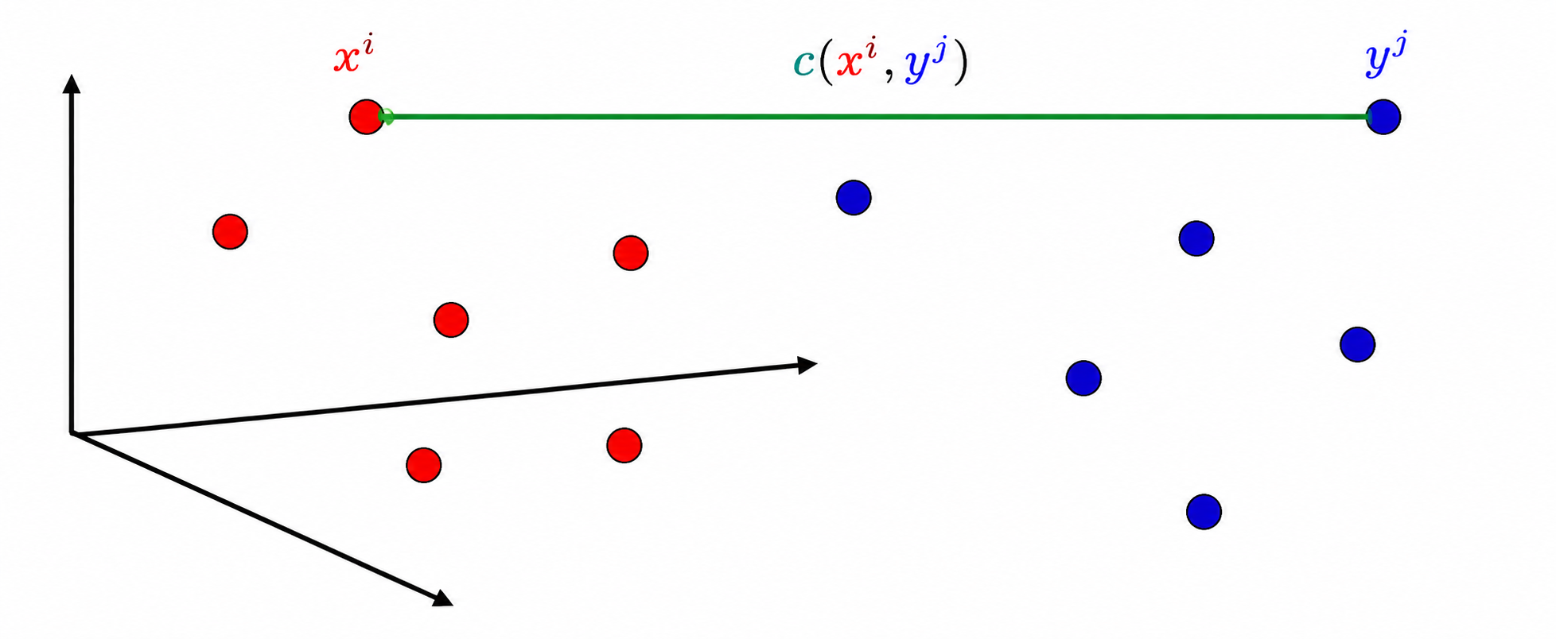
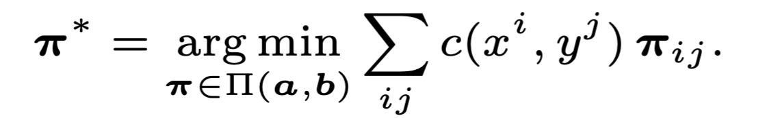
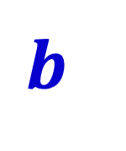
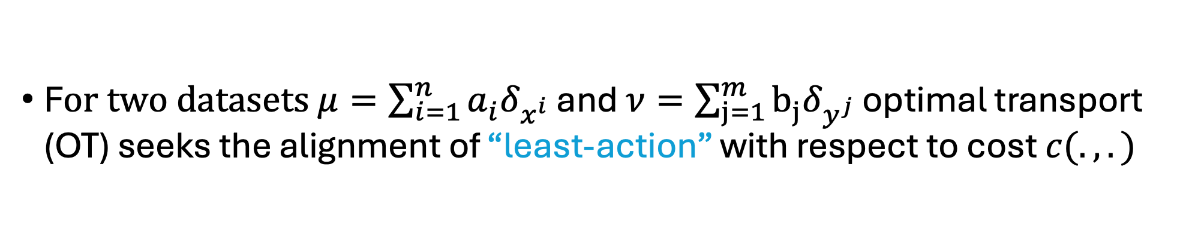

Wasserstein Optimal Transport
F$or two datasets μ=\sum_{i=1}^{n}{{a_{i}^{ }δ}_{x^{i}}}$ and $ν=\sum_{j=1}^{m}{{b_{j}^{ }δ}_{y^{j}}}$ optimal transport (OT) seeks the alignment of “least-action” with respect to cost $c(.,.)$
Wasserstein (W) OT Problem:
$$a$$
$$b$$
Coupling/Alignment Constraint:

Slide 9
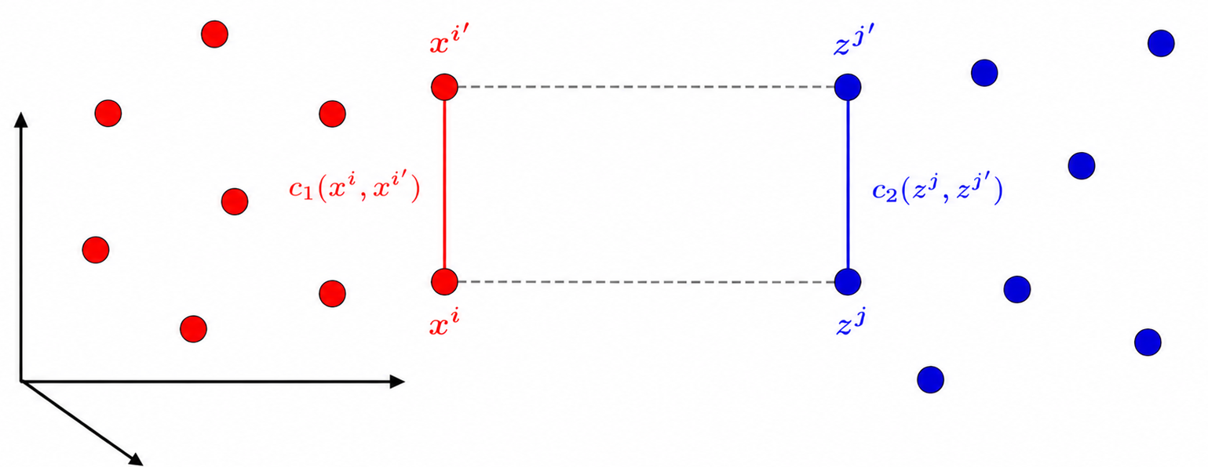
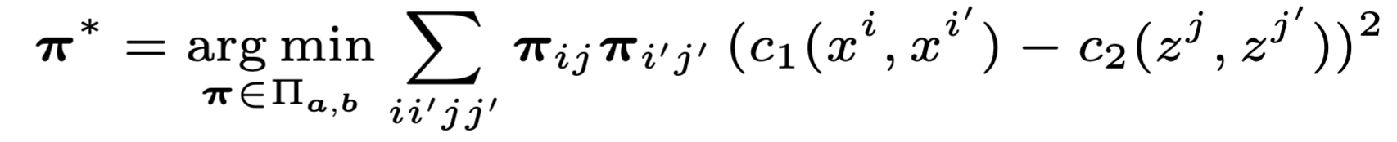

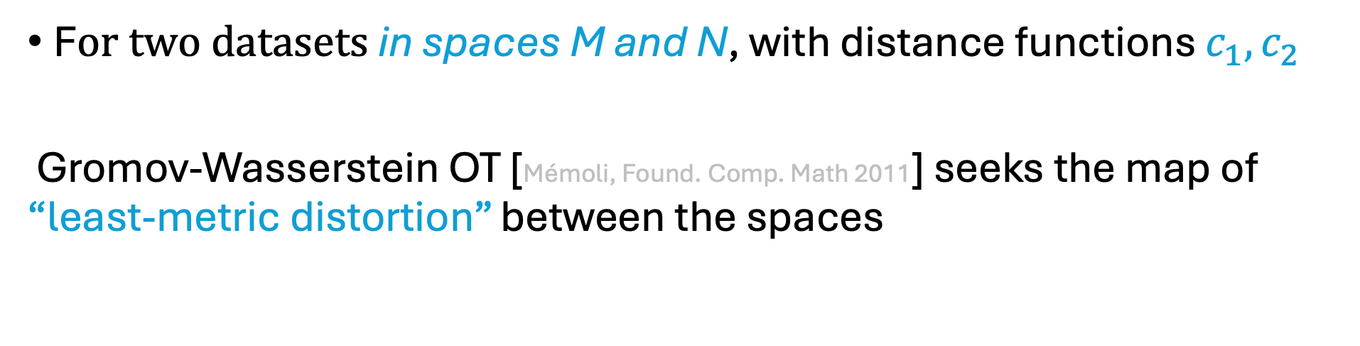

Gromov-Wasserstein Optimal Transport
F$or two datasets$in spaces M and N, with distance functions $c_{1},c_{2}$
Gromov-Wasserstein OT [Mémoli, Found. Comp. Math 2011] seeks the map of “least-metric distortion” between the spaces
Gromov-Wasserstein (GW) OT Problem:
$$a$$
$$b$$
Coupling/Alignment Constraint:

Slide 10
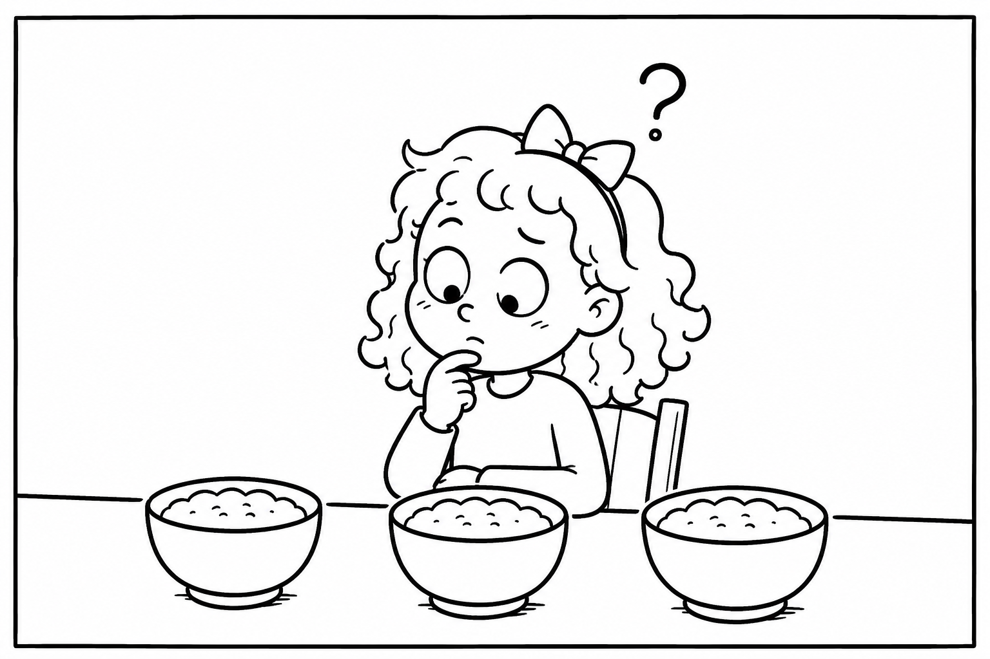
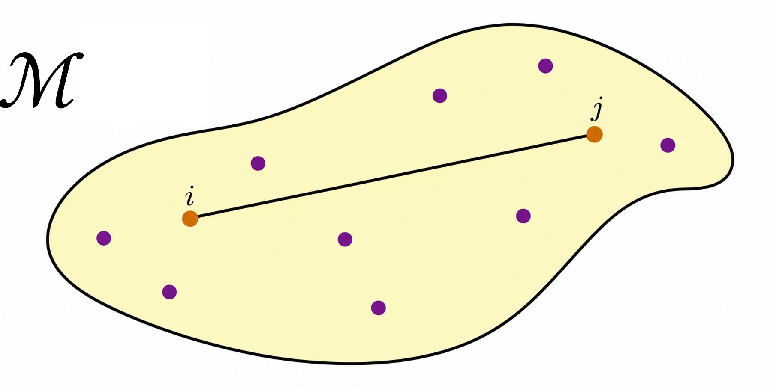
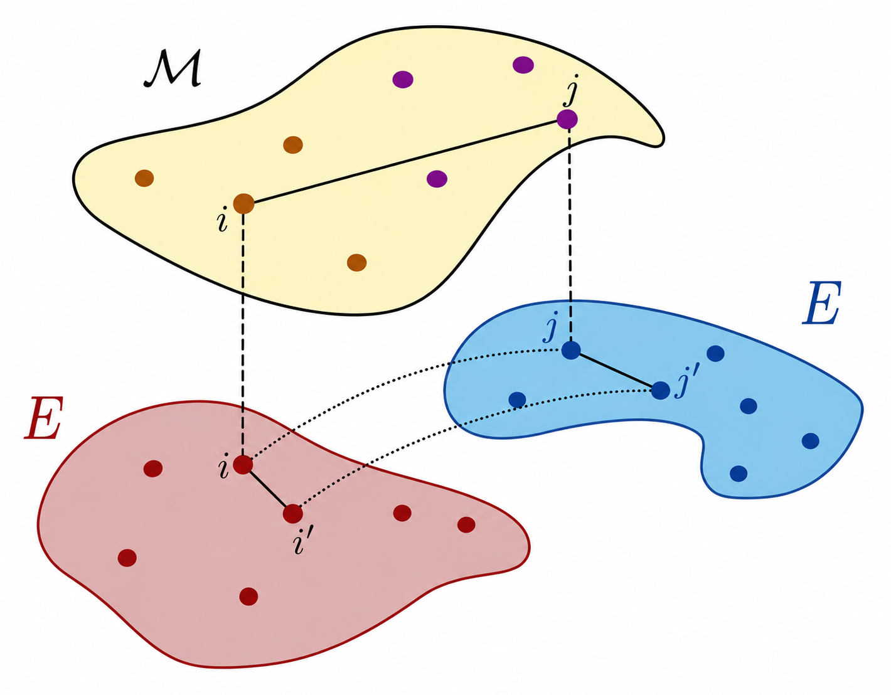
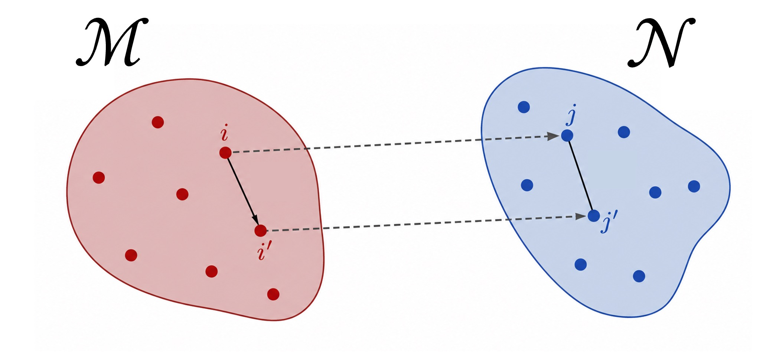
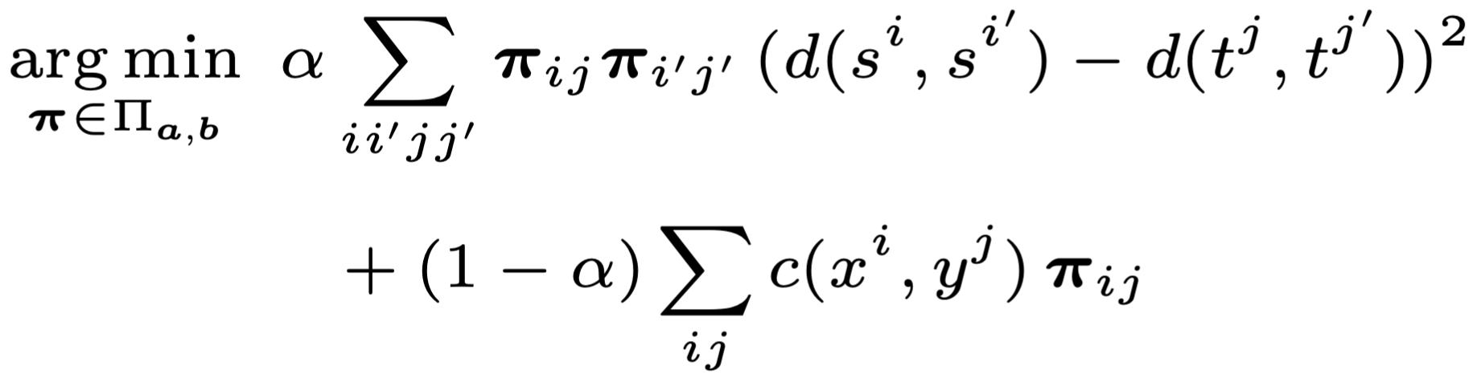
Wasserstein OT on one Feature Space
Waddington-OT [Schiebinger, et al. Cell, (2019)]
Fused GW:
GW on Physical Space,
W on Features
PASTE [Zeira, et al. Nat. Met., (2022)]
PASTE2 [Liu, et al. Gen.Bio., (2023)]
moscot [Klein, et al. Nat. Met., (2025)]
DeST-OT [Halmos & Liu et al. Cell Sys. (2025)].
Which alignment
is just right?
Gromov-Wasserstein (GW) OT on two Feature Spaces:
SCOT [Demetci, et al. JCB, (Jan. 2022)], SCOTv2 [Demetci, et al. JCB, (Nov. 2022)], moscot Translation [Klein, et al. Nat. Met., (2025)]

Slide 11
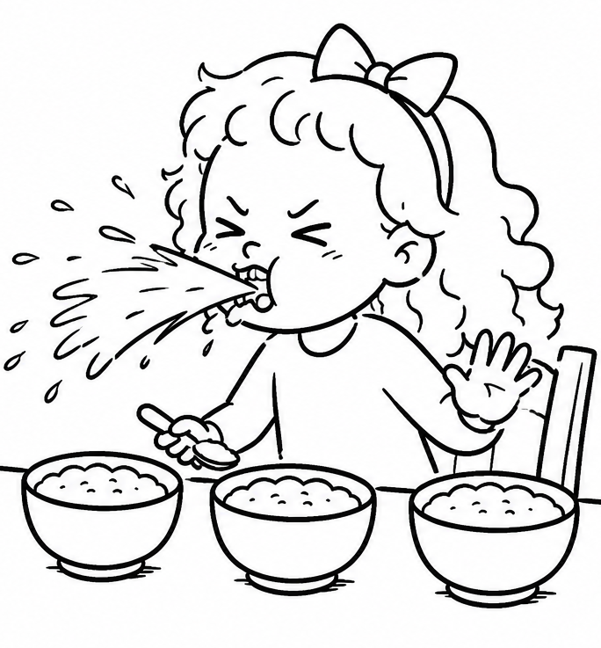
Wasserstein OT on one Feature Space
Waddington-OT [Schiebinger, et al. Cell, (2019)]
Fused GW:
GW on Physical Space,
W on Features
PASTE [Zeira, et al. Nat. Met., (2022)]
PASTE2 [Liu, et al. Gen.Bio., (2023)]
moscot [Klein, et al. Nat. Met., (2025)]
DeST-OT [Halmos & Liu et al. Cell Sys. (2025)].
This alignment can’t extend across modalities
or use physical space!
Gromov-Wasserstein (GW) OT on two Feature Spaces:
SCOT [Demetci, et al. JCB, (Jan. 2022)], SCOTv2 [Demetci, et al. JCB, (Nov. 2022)], moscot Translation [Klein, et al. Nat. Met., (2025)]
This alignment can’t extend across modalities and merges space and expression arbitrarily with a hyperparameter!
This alignment has no feature-learning and doesn’t use physical space!

Slide 12
Riemannian Metric Learning for Alignment of Spatial Multiomics
We introduce Manifold Gromov Wasserstein or MGW to align arbitrary spatial data across the multiome using the Riemannian pull-back metric
MGW uses neural metric-learning and Gromov-Wasserstein Optimal Transport on geodesics in this metric

Slide 13
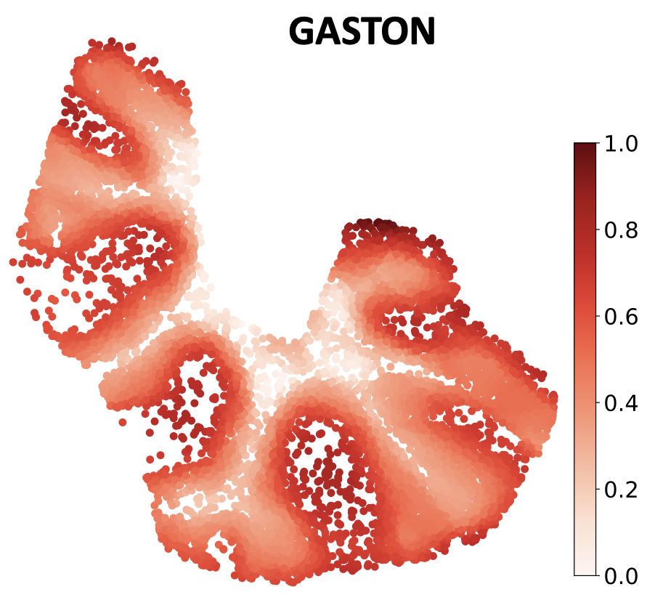
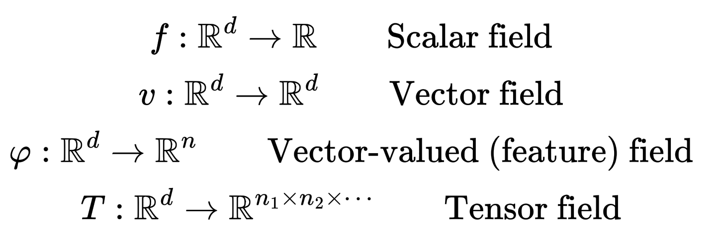
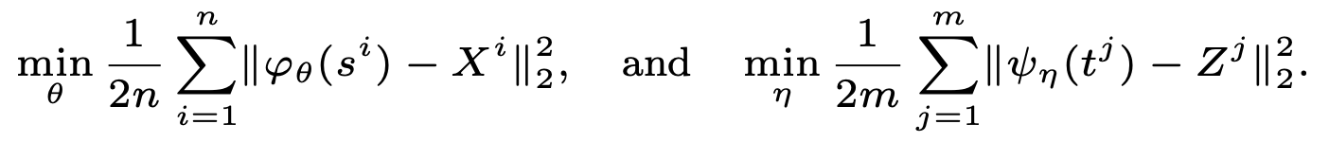

Spatial Modalities as Implicit Neural Fields
Neural fields can implicitly encode each spatial omics modality as a smooth implicit neural field [Chitra ’25 Nat. Met.]
Our approach for alignment is to first learn a pair of implicit mappings from the base space $s,t ∈E$ into the modalities $X ∈M, Z ∈N$
Neural field representations allow us to efficiently learn and compute (spectrally-filtered) gradients and curvature via automatic differentiation

Slide 14
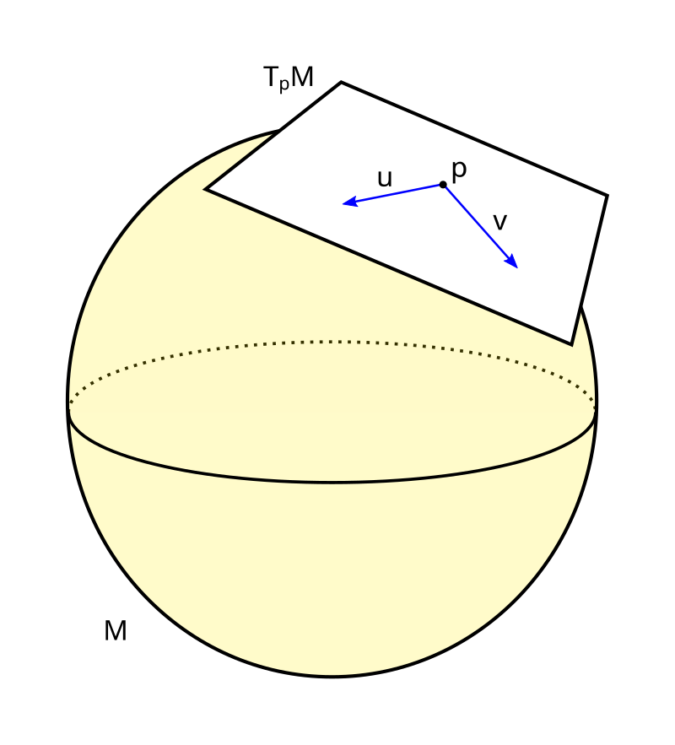
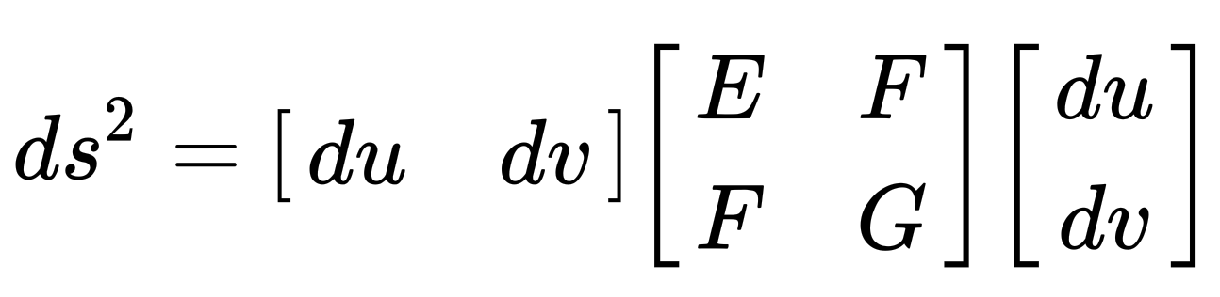
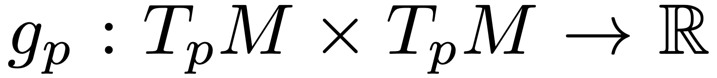

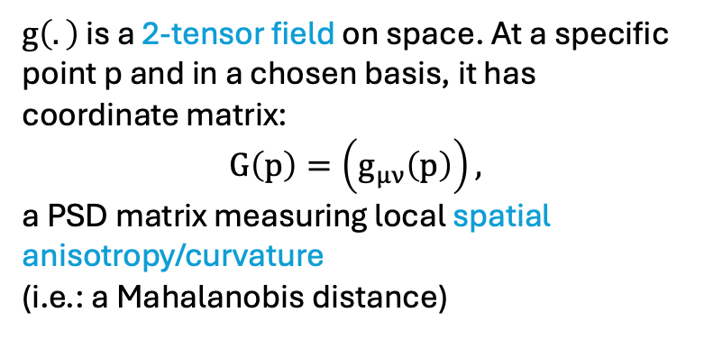
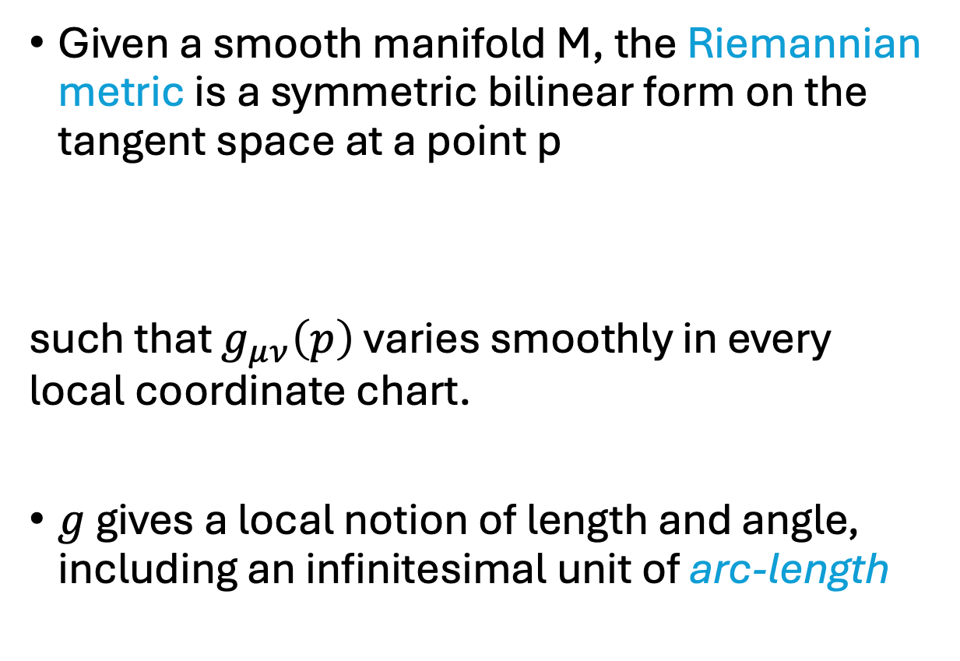
Metric Tensor $g_{μν}$
Given a smooth manifold M, the Riemannian metric is a symmetric bilinear form on the tangent space at a point p
such that $g_{μν}\left(p\right)$ varies smoothly in every local coordinate chart.
$g$ gives a local notion of length and angle, including an infinitesimal unit of arc-length
$g\left(.\right)$ is a 2-tensor field on space. At a specific point p and in a chosen basis, it has coordinate matrix:
$$G\left(p\right)=\left(g_{μν}\left(p\right)\right),$$
a PSD matrix measuring local spatial anisotropy/curvature
(i.e.: a Mahalanobis distance)

Slide 15
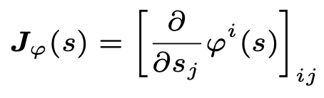
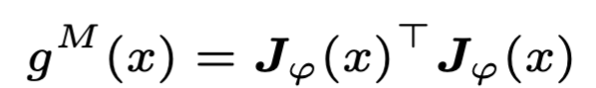
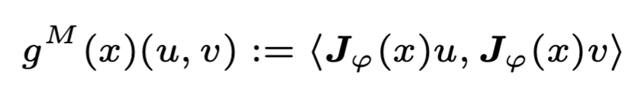
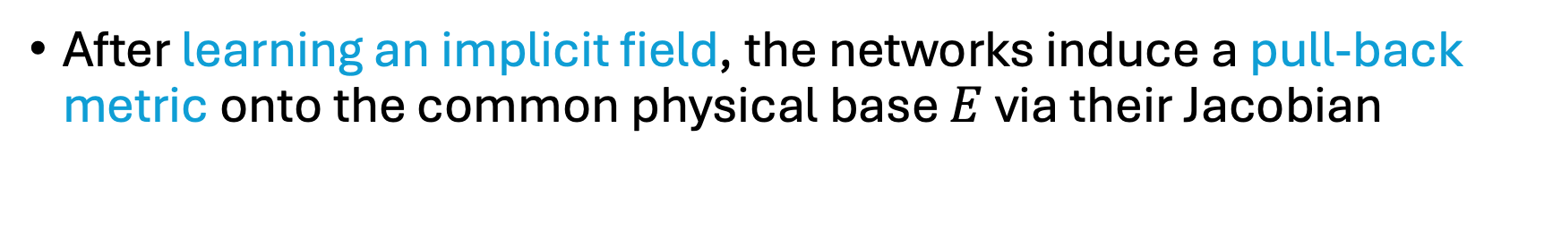
Riemannian Pull-Back Metric
After learning an implicit field, the networks induce a pull-back metric onto the common physical base $E$ via their Jacobian
Jacobian:
Pull-back metric:
(Resp. for the second modality N)

Slide 16
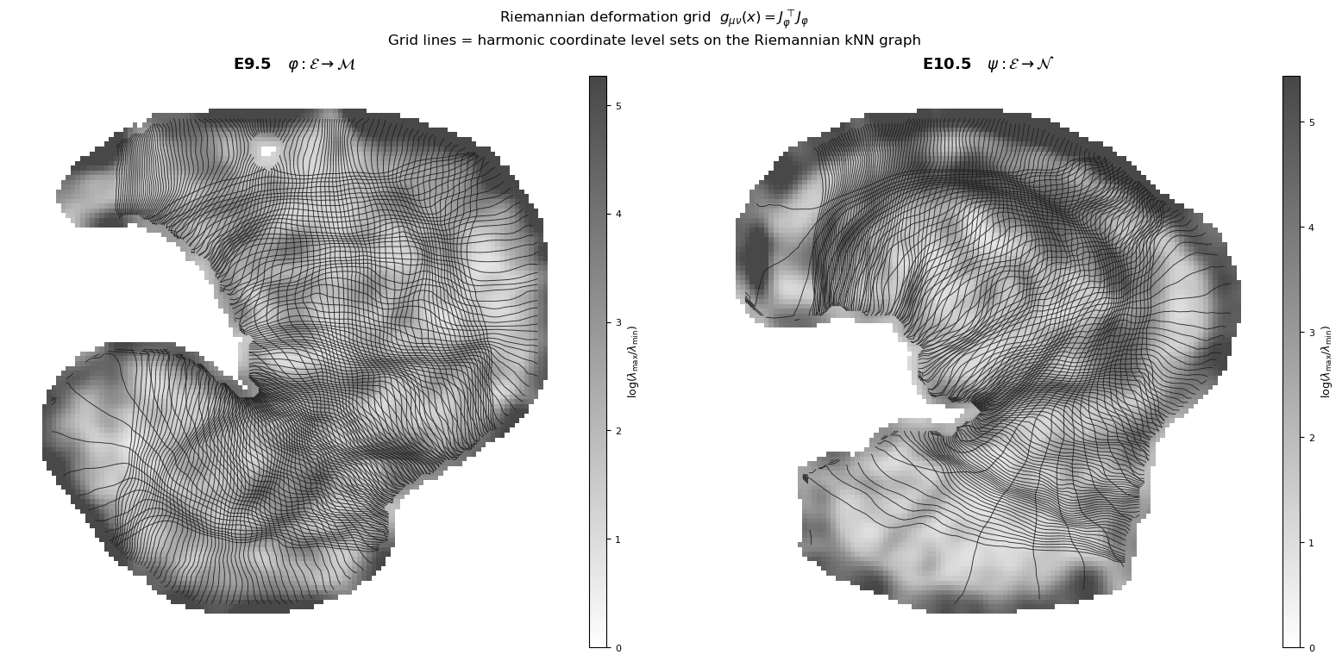
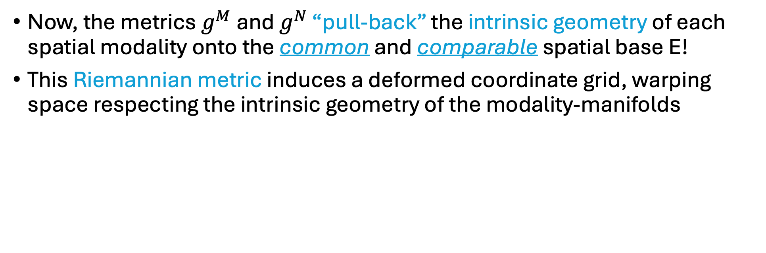
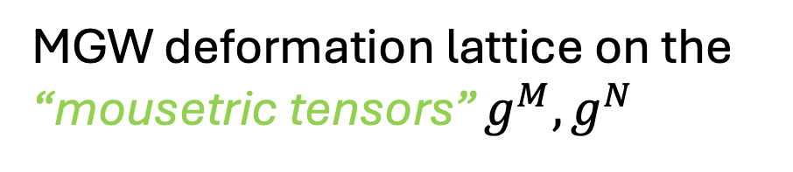
Riemannian Geometry of Spatial Multiomics
Now, the metrics $g^{M}$ and $g^{N}$ “pull-back” the intrinsic geometry of each spatial modality onto the common and comparable spatial base E!
This Riemannian metric induces a deformed coordinate grid, warping space respecting the intrinsic geometry of the modality-manifolds
MGW deformation lattice on the
“mousetric tensors” $g^{M},g^{N}$

Slide 17
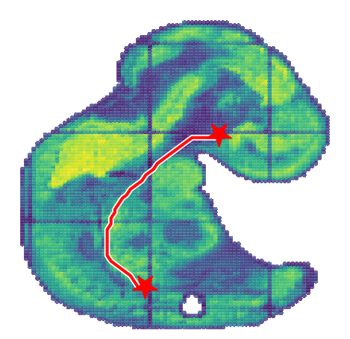
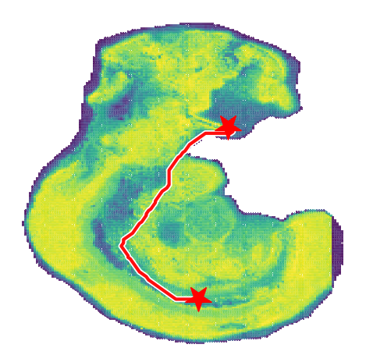
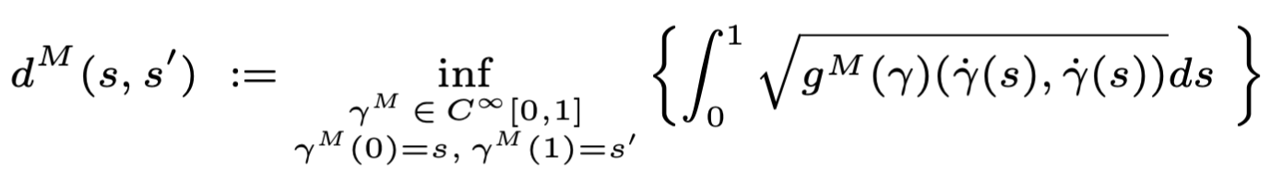
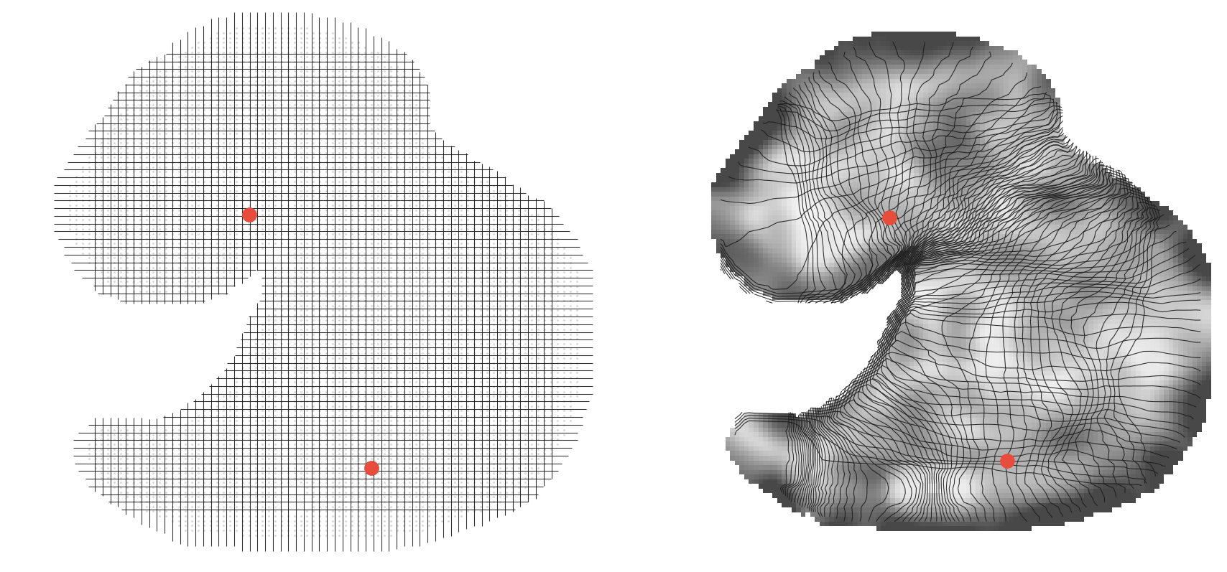

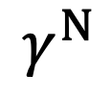
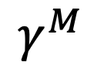
Riemannian Geodesics
We use the metric to compute geodesics between each pair of points:
$$γ^{M}$$
$$γ^{N}$$
Riemannian Geodesics
Identity (Euclidean) metric
MGW Riemannian metric

Slide 18
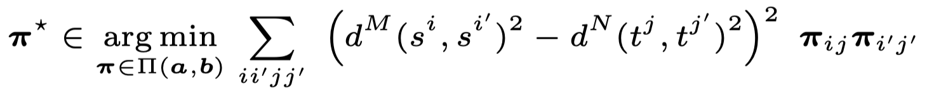



Riemannian Geodesics
The final step of MGW is Gromov-Wasserstein Optimal Transport on the (Riemannian) geodesic distances:
$$γ^{M}$$
$$γ^{N}$$
$$π$$
Riemannian Geodesics
MGW Coupling

Slide 19


Slide 20

MGW
  One intrinsic objective, for arbitrary (smooth) modalities!
  Theoretical invariances to non-intrinsic coordinate transformations [Supplement Prop.1 & Prop.2]
  No objective hyperparameters! Don’t need the $α$ of FGW.

Slide 21

Spatiotemporal Mouse Embryogenesis
Convert unimodal mouse spatiotemporal transcriptomics dataset [Chen et al. 2022] to “multi-modal:”
No cross-dataset expression distances!
Ablation against GW-based multi-modal approaches [Demetci, et al. JCB, (Nov. 2022), Klein, et al. Nat. Met., (2025)]:
  MGW achieves high spatial realism while simultaneously accurate with respect to the ground-truth expression and cell-type annotations [Chen et al. 2022].

Slide 22



Spatial Metabolomics-Transcriptomics
(Human Striatum)
x
Dopamine prediction task of striatum [Vicari, ’23]:
  Metabolomic (MALDI-MSI) x transcriptomic (Visium) modalities with “ground-truth” dopamine-high neurons [Vicari, ’23] and dopaminergic metabolites (incl. DA single, DA double, 3MT)
Align [MGW, Spatial GW, SCOTv1, SCOTv2, moscot Translation, PASTE2], and perform barycentric projection to transfer all metabolites onto the Visium slide
Visium
Annotated labels [Vicari, ’23]
After aligning, can “color” each dataset with new modality:
👉
MALDI MSI
Doubly derivatized dopamine,
m/z=674.286

Slide 23
Spatial Metabolomics-Transcriptomics (Human Striatum)
Compute how well dopaminergic metabolite projection predicts the binary dopamine label of the Visium via AUPRC and AUROC
x
x

Slide 24

Metabolomics-Transcriptomics Alignment of
Human Clear Cell Renal Cell Carcinoma (ccRCC)
Evaluated MGW on two tissue slices from ccRCC with AFADESI-MSI metabolomics and 10X Genomics Visium
Outperforms non-OT techniques SpatialMeta [Tian, et al. Nat. Comm., (2025)] and OT-based techniques [Demetci et al., 2022a, Demetci et al., 2022b, Klein et al., 2025], and GW baselines in spatial and cluster continuity metrics
Additionally demonstrate MGW on Visium-Xenium alignment of Colorectal Cancer (see paper)

Slide 25
Summary
MGW can be used to align spatial multiomic data with neural metric learning and Gromov-Wasserstein Optimal Transport.
Simple and robust approach (with strong theoretical properties) for aligning spatial data across the multiomic universe!
Thank you!
Code and demos are publicly available at:
https://github.com/raphael-group/MGW
Paper
Code

Slide 26



Acknowledgments
Raphael Group
Prof. Ben Raphael
Dr. Yihang Shen
Dr. Hongyu Zheng
Noah Cape
Annita Chang
Viola Chen
Gillian Chu
Khai Evdaev
Peter Halmos
William Howard-Snyder
Gary Hu
Akhil Jakatdar
Xavi Loinaz
Yufan Xia
Richard Zhang
Clover Zheng
John Zhou

